Slide 1
DDD cz1.
Domain encapsulation

Slide 2
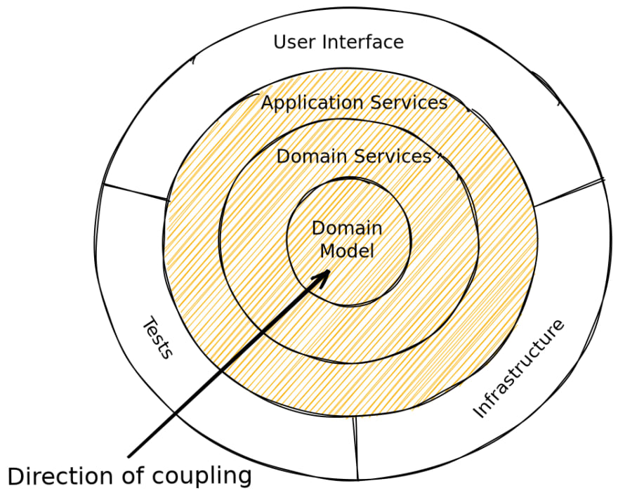
Onion Architecture
Onion architecture is built on a domain model in which layers are connected through interfaces. The idea is to keep external dependencies as far outward as possible where domain entities and business rules form the core part of the architecture. It provides flexible, sustainable and portable architecture
https://dev.to/barrymcauley/onion-architecture-3fgl

Slide 3
sample project concept
UC1: create order
UC2: assign workers
UC3: assign measurement to order
MODEL: WorkOrder, Spool, Weld, Measurement, Worker (Manager/Welder), Tenant, Team

Slide 4
Domain
Technical sophisticated: A domain is the targeted subject area of a computer program
Technical simple: something blurry
Phylosophical : a sphere of knowledge and activities around those sphere
Business: department i belong to

Slide 5
Aggregate Pattern
Aggregation implies that one object owns or is responsible for another object or objects set
Integrity of an aggregate as a whole has to be ensured.
Aggregate fires EVENTS in case of EDA

Slide 6
AggregateRoot, Entity, ValueObject
AR Boundries
Immutability & Invariants

Slide 7
Business Logic
Entity - invariants handling logic
Domain Services - use if logic breakse entity / vo isolation
Application Services - orchestrate domain knowledge with external world

